Slide 1


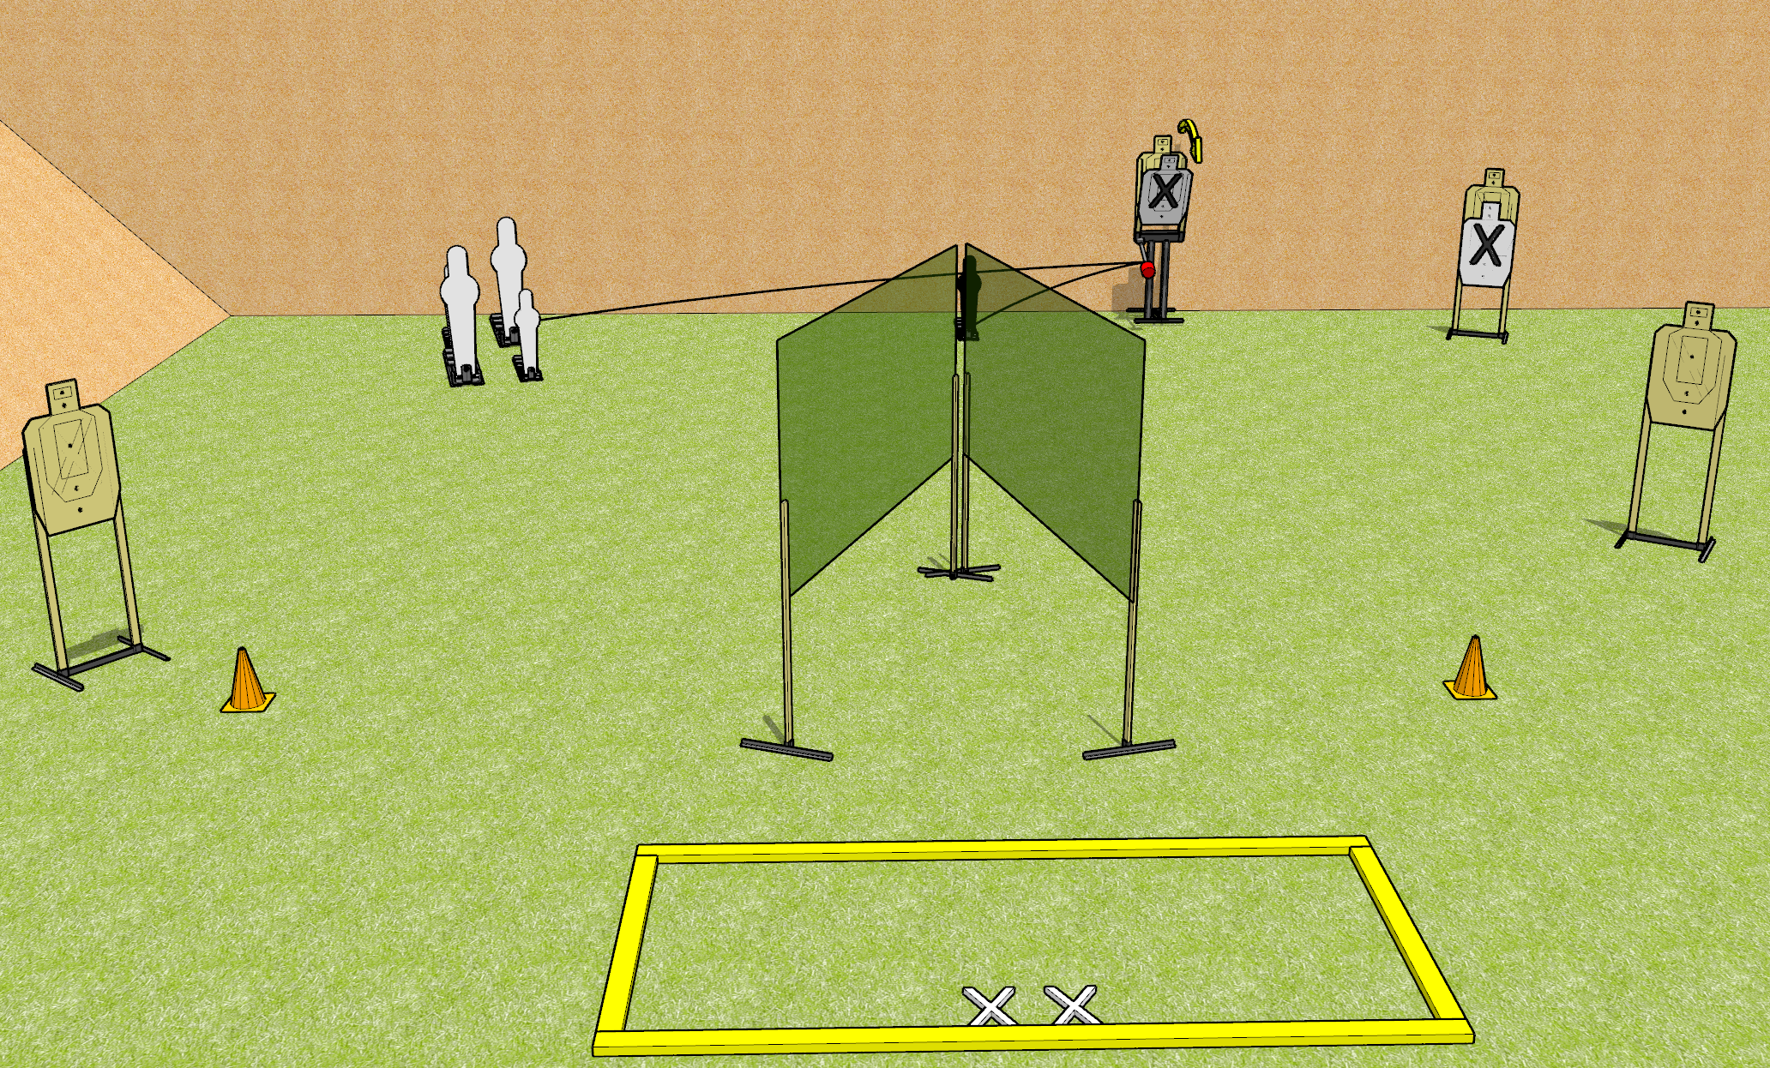
 | Dothan Gun Club – USPSA Match Max Option Course Designer : Drew Coleman
START POSITION : Standing with both feet on X’s, heels against rear fault line
GUN READY CONDITION : Pistol loaded and holstered. PCC shouldered, safety on, pointed at either orange cone. |  | SCORING: Comstock, 12 rounds TARGETS: 4 paper, 4 Steel SCORED HITS: Best 2 on paper, steel until down START-STOP: Audible, last shot RULES: The black mini popper nearest the max trap is not a scoring target, but can be shot to activate the max trap.
STAGE PROCEDURE: Engage targets as they become available from within the fault lines

